Slide 1
Capturing the Tacit Knowledge
Knowledge Capture can be defined as the process by which knowledge is converted from tacit to explicit form (residing within people, artifacts or organizational entities) and vice versa through the sub-processes of externalization and internalization.
In this case, the knowledge developer collaborates with the expert in order to convert the expertise into the necessary program code(s).
Important steps:
Using appropriate tools for eliciting information.
Interpreting the elicited information and consequently inferring the experts underlying knowledge/reasoning process.
Finally, using the interpretation to construct the the necessary rules which can represent the experts reasoning process.
Notes:
Knowledge is available in either explicit(books, manuscripts, reports )or tacit form,

Slide 2
Knowledge Capturing Techniques
On-Site Observation (Action Protocol)
It is a process which involves observing, recording, and interpreting the expert's problem solve process while it takes place.
The knowledge developer does more listening than talking; avoids giving advice and usually does not pass his/her own judgment on what is being observed, even if it seems incorrect; and most of all, does not argue with the expert while the expert is performing the task.
Compared to the process of interviewing, on-site observation brings the knowledge developer closer to the actual steps, techniques, and procedures used by the expert.
One disadvantage is that sometimes some experts to not like the idea of being observed.
The reaction of other people (in the observation setting) can also be a problem causing distraction.
Another disadvantage is the accuracy/completeness of the captured knowledge.
Notes:
In this process, the knowledge developer observes and interprets and record the expert while he or she solves problems, knowledge developer does more listening and observing than asking questions
Best suited for single expert module.

Slide 3
Brainstorming
It is an unstructured approach towards generating ideas about creative solution of a problem which involves multiple experts in a session.
In this case, questions can be raised for clarification, but no evaluations are done at the spot.
Similarities (that emerge through opinions) are usually grouped together logically and evaluated by asking some questions like:
What benefits are to be gained if a particular idea is followed.
What specific problems that idea can possibly solve.
What new problems can arise through this.
The general procedure for conducting a brainstorming session:
Introducing the session.
Presenting the problem to the experts.
Prompting the experts to generate ideas.
Looking for signs of possible convergence.
If the experts are unable to agree on a specific solution, they knowledge developer may call for vote/consensus.
Notes:
Usually for multiple experts , where they share their ideas and opinions about the solution to a problem, no eveluations are done on the spot

Slide 4
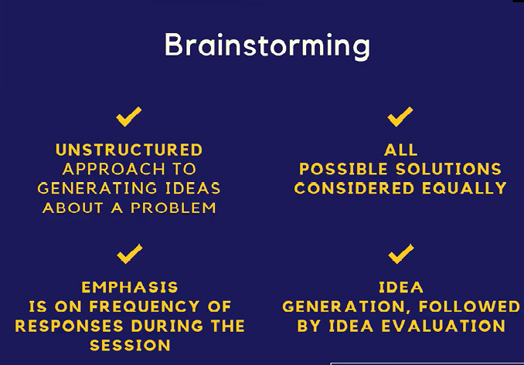

Slide 5
Electronic Brainstorming
Is a computer-aided approach for dealing with multiple experts.
It usually begins with a pre-session plan which identifies objectives and structures the agenda, which is then presented to the experts for approval.
During the session, each expert sits on a PC and get themselves engaged in a predefined approach towards resolving an issue, and then generates ideas.
This allows experts to present their opinions through their PC's without having to wait for their turn.
Usually the comments/suggestions are displayed electronically on a large screen without identifying the source.
This approach protects the introvert experts and prevents tagging comments to individuals.
The benefit includes improved communication, effective discussion regarding sensitive issues, and closes the meeting with concise recommendations for necessary action
This eventually leads to convergence of ideas and helps to set final specifications.
The result is usually the joint ownership of the solution.

Slide 6
Protocol Analysis (Think-Aloud Method)
In this case, protocols (scenarios) are collected by asking experts to solve the specific problem and verbalize their decision process by stating directly what they think.
Knowledge developers do not interrupt in the interim.
The elicited information is structured later when the knowledge developer analyzes the
protocol.
Here the term scenario refers to a detailed and somehow complex sequence of events or more precisely, an episode.
A scenario can involve individuals and objects.
A scenario provides a concrete vision of how some specific human activity can be supported by information technology.
Notes:
In this technique, the knowledge developer ask questions about a problem or scenario, experts are required to give detailed explanation and verbalize the process while solving the problem, or taking a particular decision with reasons

Slide 7
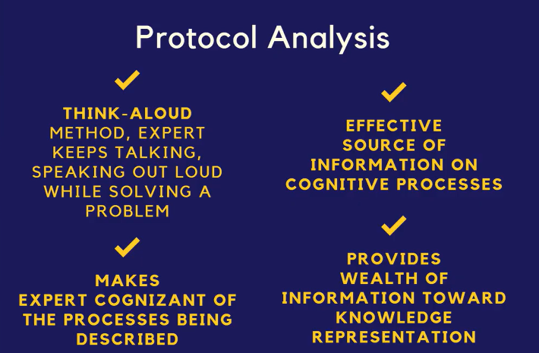

Slide 8
Repertory Grid
This is a tool used for knowledge capture.
The domain expert classifies and categorizes a problem domain using his/her own model.
The grid is used for capturing and evaluating the expert's model.
Two experts (in the same problem domain) may produce distinct sets of personal and subjective results.
The grid is a scale (or a bipolar construct) on which elements can be placed within gradations.
The knowledge developer usually elicits the constructs and then asks the domain expert to provide a set of examples called elements.
Each element is rated according to the constructs which have been provided.
Notes:
The repertory grid is a way of carrying out an interview in a highly structured manner, using the interviewee's own language and setting out their responses in the form of a grid.
A big advantage of the repertory grid technique is that it allows interviewees to articulate their experience in the way they see the world, according to their own personal constructs.
With this technique the knowledge developer frames a scale and experts are asked to fill up the scale, here experts must think properly to ascertain and assign the appropriate values for each element

Slide 9
Consensus Decision Making
Consensus decision making usually follows brainstorming.
It is effective if and only if each expert has been provided with equal and adequate opportunity to present their views.
In order to arrive at a consensus, the knowledge developer conducting the exercise tries to rally the experts towards one or two alternatives.
The knowledge developer follows a procedure designed to ensure fairness and standardization.
This method is democratic in nature.
This method can be sometimes tedious and can take hours.
Notes:
This is similar to brainstorming or more or less a follows after but have a problem or knowledge domain., Each expert in a communication panel will come out with their views or proposals about a specific knowledge domain. Various proposals will be selected and by consensus a final decision or specific solutions or alternatives aer agreed on.

Slide 10
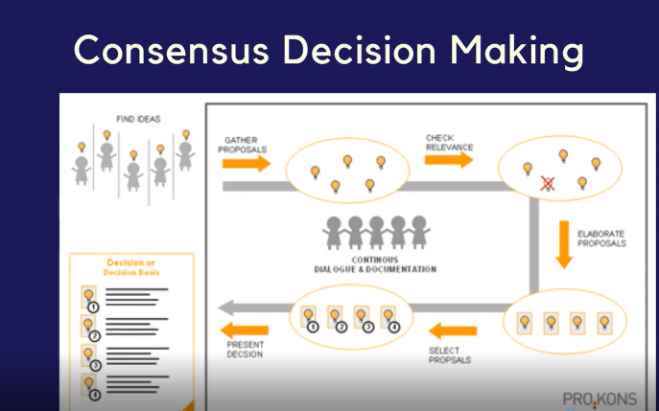

Slide 11
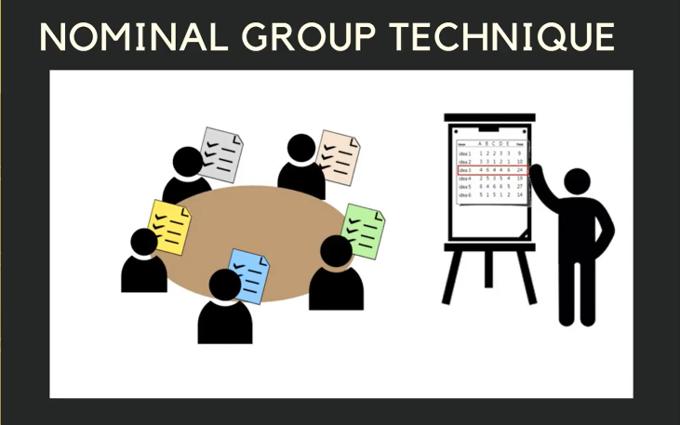
Nominal Group Method
This provides an interface between consensus and brainstorming.
Here the panel of experts becomes a Nominal Group whose meetings are structured in order to effectively pool individual judgment.
Notes:
Example: The knowledge developer posses a problem, each expert is expected to give solutions to the problem. Experts will share their ideas,Then experts will agree on common solutions to the given probelm

Slide 12
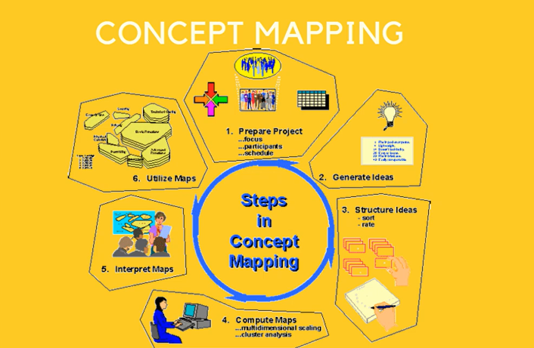

Slide 13
Concept Mapping
It is a network of concepts consisting of nodes and links.
A node represents a concept, and a link represents the relationship between concepts
Concept mapping is designed to transform new concepts/propositions into the existing
cognitive structures related to knowledge capture.
It is a structured conceptualization.
It is an effective way for a group to function without losing their individuality.
Concept mapping can be done for several reasons:
To design complex structures.
To generate ideas.
To communicate ideas.
To diagnose misunderstanding.

Slide 14
Blackboarding
In this case, the experts work together to solve a specific problem using the blackboard as their workspace.
Each expert gets equal opportunity to contribute to the solution via the blackboard.
It is assumed that all participants are experts, but they might have acquired their individual expertise in situations different from those of the other experts in the group.
The process of blackboarding continues till the solution has been reached.
Characteristics of blackboard system:
Diverse approaches to problem-solving.
Common language for interaction.
Efficient storage of information
Flexible representation of information.
Iterative approach to problem-solving.
Organized participation.

Slide 15
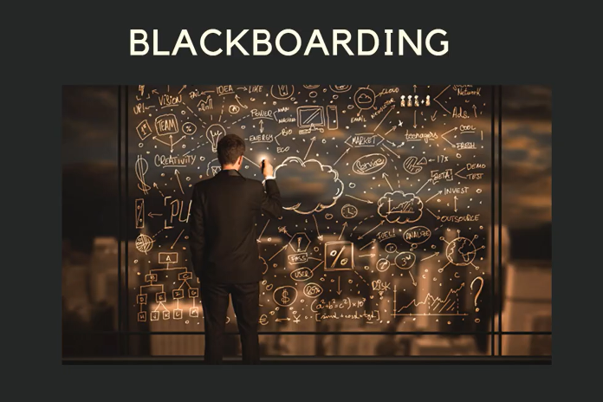

Slide 16
Knowledge Codification
Knowledge codification means converting tacit knowledge to explicit knowledge in a usable form for the organizational members.
Tacit knowledge (e.g., human expertise) is identified and leveraged through a form that is able to produce highest return for the business.
Explicit knowledge is organized, categorized, indexed and accessed.
The organizing often includes decision trees, decision tables etc.
Codification must be done in a form/structure which will eventually build the knowledge base.
Notes:
Refers to the process of converting tacit knowledge (knowledge that is personal, context-specific, and hard to formalize) into explicit knowledge (knowledge that is easily communicated and shared through documentation). This process involves documenting, organizing, and storing knowledge so that it can be accessed and utilized by others within an organization. Codification ensures that valuable information is not lost and can be leveraged for decision-making, problem-solving, and innovation.odification

Slide 17
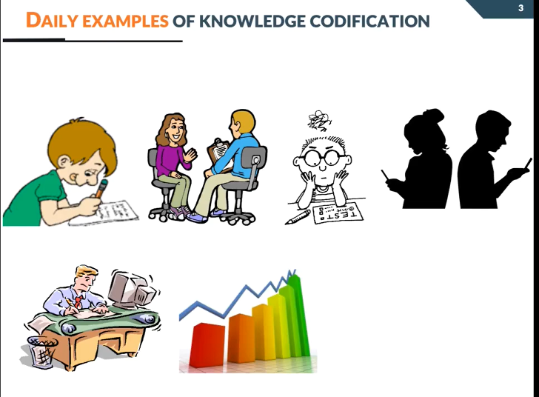
Notes:
Knowledge codification is essential for any knowledge intensive activity
Definition: The process of transferring tacit knowledge to explicit knowledge

Slide 18
The resulting knowledge base supports training and decision making.
Diagnosis.
Training/Instruction.
Interpretation.
Prediction.
Planning/Scheduling

Slide 19
Modes of Knowledge Conversion
Conversion from tacit-to-tacit knowledge produces socialization where knowledge developer looks for experience in case of knowledge capture.
Conversion from tacit to explicit knowledge involves externalizing, explaining or clarifying tacit knowledge via analogies, models, or metaphors.
Conversion from explicit to tacit knowledge involves internalizing (or fitting explicit knowledge to tacit knowledge.
Conversion from explicit-to-explicit knowledge involves combining, categorizing, reorganizing or sorting different bodies of explicit knowledge to lead to new knowledge

Slide 20
Codifying Knowledge
Things to Consider before Codification:
What organizational goals will the codified knowledge serve?
What knowledge exists in the organization that can address these goals?
How useful is the existing knowledge for codification?
How would someone codify knowledge
Notes:
Codifying tacit knowledge (in its entirety) in a knowledge base or repository is often difficult
because it is usually developed and internalized in the minds of the human experts over a long
period of time

Slide 21
Aims of Codification
Preservation of Knowledge:
Documentation: Ensuring that critical knowledge, especially that which resides in the minds of employees, is documented and preserved. This is crucial for maintaining continuity, especially when employees leave or retire.
Historical Records: Keeping records of past projects, decisions, and processes to learn from previous successes and mistakes.

Slide 22
Aims of Codification
Facilitation of Knowledge Sharing:
Accessibility: Making knowledge easily accessible to all members of the organization, thereby enabling them to find the information they need quickly and efficiently.
Collaboration: Encouraging collaboration by providing a shared knowledge base where employees can contribute to and access collective insights.

Slide 23
Aims Contd.
Standardization of Processes:
Consistency: Standardizing procedures and best practices across the organization to ensure consistency in operations and quality.
Training and Development: Providing a basis for training materials and programs that can be used to educate new employees and develop existing staff.

Slide 24
Aims
Improvement of Decision-Making:
Data-Driven Decisions: Supporting decision-making processes by providing comprehensive, accurate, and up-to-date information.
Reduced Redundancy: Minimizing the duplication of effort by ensuring that knowledge is reused rather than recreated.

Slide 25
Enhancement of Organizational Efficiency:
Streamlined Operations: Streamlining operations by reducing the time spent searching for information and allowing employees to focus on more productive tasks.
Innovation and Improvement: Facilitating innovation by providing a repository of knowledge that can be used to inspire new ideas and improvements.

Slide 26
Support for Knowledge Continuity:
Succession Planning: Assisting in succession planning by ensuring that critical knowledge is transferred and remains within the organization even as personnel changes occur.
Risk Mitigation: Reducing the risk associated with the loss of key personnel by codifying their knowledge.

Slide 27
Codifying tacit knowledge (in its entirety) in a knowledge base or repository is often difficult because it is usually developed and internalized in the minds of the human experts over a long period of time.
Codification Tools/Procedures
Knowledge Maps
Decision Table
Decision Tree
Frames
Production Rules
Case-Based Reasoning
Knowledge-Based Agents

Slide 28
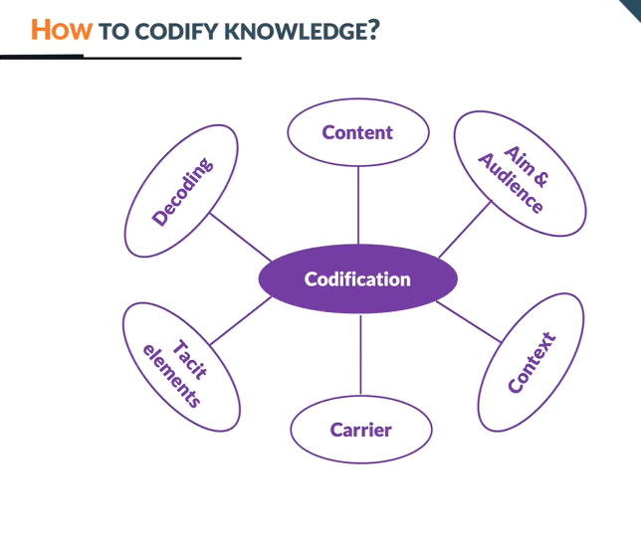
Notes:
Content:
1.Which knowledge domains are critical for codification; organizations should prioritize the critical for the organization.
2. Nature of Knowledge: some knowledge are explicable and can be easily codified: How to do online check-in at the airport, online booking etc, How to create a painting masterpiece like the Monalisa
Aim And Audience: mindful of the potential audience, there is the need for cost benefit analysis to ascertain the cost of codification and benefits of the codification to the organization.
Reading Assignment: Let s read about How Davenport:
Context: What are the incentives or the motivation for the codification process, why should experts avail themselves for the process. What are the power and political gains what, who losses or who gains. What are the daily practices, can codification be part of daily activities.
Carrier: Text, Graphical elements i.e., graphs, tables, chart etc, auidio, software, video etc
Tacit elements: how codified elements is linked with the tacit elements; E.g. Flow chart of assemble a product(encoded), knowing how to read and understand the flow and the abbreviations etc
Decoded: The codified knowledge should be understood by the receivers otherwise it cannot be used. Its necessary you have some knowledge in the knowledge domain

